Slide 1
Stimulus and ESSER
funding for K-12
education
hello, I’m First Name
Full Name
Job Title
District/School
Email Address
Phone Number
@Twitter
Notes:
Customize this slide with relevant district/school and personal details.

Slide 2
How can we choose technology to help all learners achieve their potential?
Notes:
We all know there’s value in carefully selected edtech tools, but how can we choose which ones help our learners to fully achieve their potential?

Slide 3
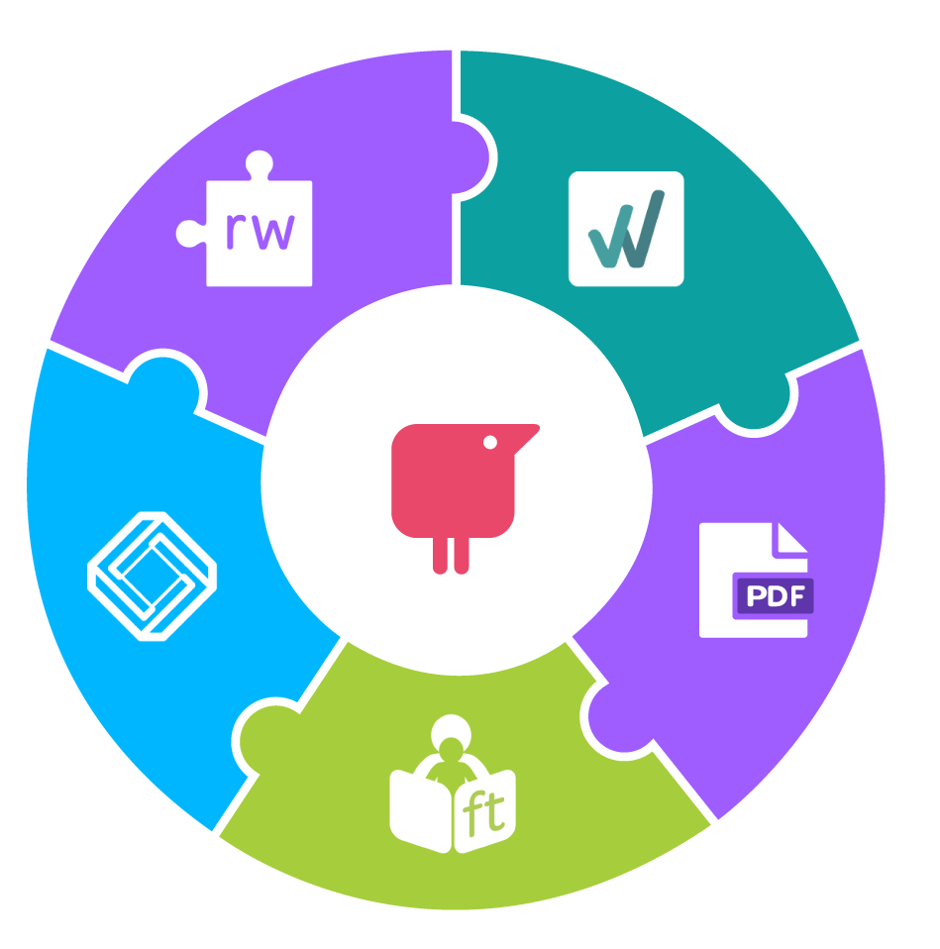
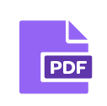
Why Texthelp Tools?
Texthelp tools offer a complete, systematic solution for teachers & students. Across the curriculum, for every platform.
Literacy & Language support, feedback & accessibility
Integrated assessment & feedback of writing assignments
PDF Resource creation, worksheet completion & marking
Practice Reading Aloud, assessment and feedback
Math resource creation, assignment, assessment, PDF/Docs/Word math tools
Notes:
What Sets Texthelp Tools apart:
At Texthelp we’ve been creating software focused on teaching and learning for over 20 years. With over 30 million users, we’ve built a comprehensive suite of tools that work on any platform, supporting any content across literacy, language, math and science. Our online solutions are essential tools for every aspect of remote learning. Innovative and proven - software that’s designed for learning, everywhere.
Read&Write supports literacy and language development, providing multiple means of feedback and accessibility so each student can access the curriculum.
WriQ is a writing achievement tool that supports both students and teachers through writing instruction. Technology assisted marking helps teachers take time back whilst the student experience allows students to take charge of their own learning, nudging them to do a little better each day, and only ever in competition with themselves.
Texthelp’s PDF technology allows teachers and students to interact with usually locked-down PDF documents, or turn paper classroom resources into digital ones, so that every student can access the content, whether working from home or in the classroom with their peers.
Fluency Tutor for Google allows teachers to track and assess progression in reading, right from their computer screen. Students no longer need to stand at a teacher’s desk and read aloud in front of their peers. With Fluency Tutor, they can record their reading and share directly with their teachers. Great for consistency in a blended learning environment.
EquatIO brings math into the digital era, allowing students and their teachers to interact with many math and STEM formulas, manipulatives, equations, graphs and more. It’s the perfect tool for collaboration in math, providing equal access to content - including those with learning disabilities and visual impairments in classroom activities alongside their peers.

Slide 4
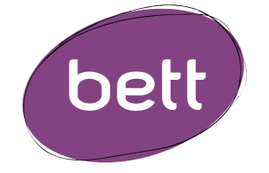
National and International Awards
Texthelp has won numerous awards over the years. Recently three of our products - EquatIO, WriQ and Fluency Tutor were awarded the Tech and Learning Awards of Excellence for Remote Learning.
These awards recognize the work of technology providers, whose solutions were key to delivering continuous learning during the Covid-19 pandemic.
Notes:
For the last year, there has been a greater demand than ever for tools and technology that can help children and young people learn at home and at school. These technologies have made continued education possible during the pandemic. They’ve also helped to decrease learning loss.
After this unusual year our friends at Tech and Learning Magazine saw it fitting to add a new category to their "Awards of Excellence" program. The new "Best Remote/Blended Learning Tools" category. These awards recognize the work of technology providers, whose solutions were key to delivering continuous learning.
We were delighted when three of our products, WriQ, Equatio, and Fluency Tutor were awarded “Best Remote/Blended Learning Tools” across primary and secondary grades. It is important to us that we provide a solution for school pupils of all age groups, from the youngest to the oldest.

Slide 5
Explore how our evidence-based EdTech support solutions align with stimulus and ESSER
funding guidance

Slide 6
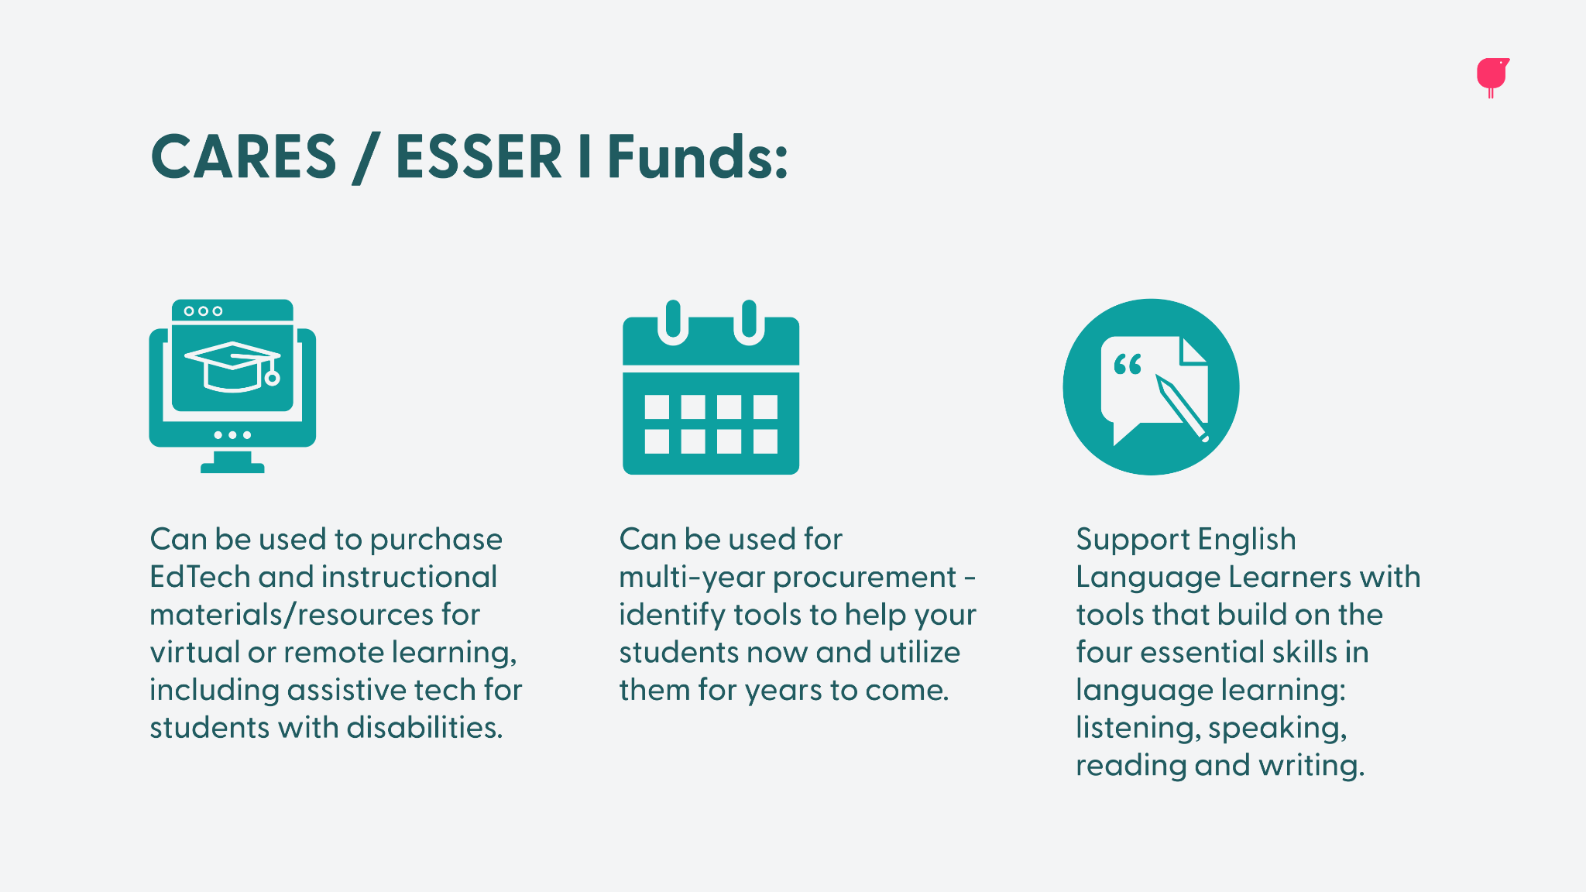

Slide 8
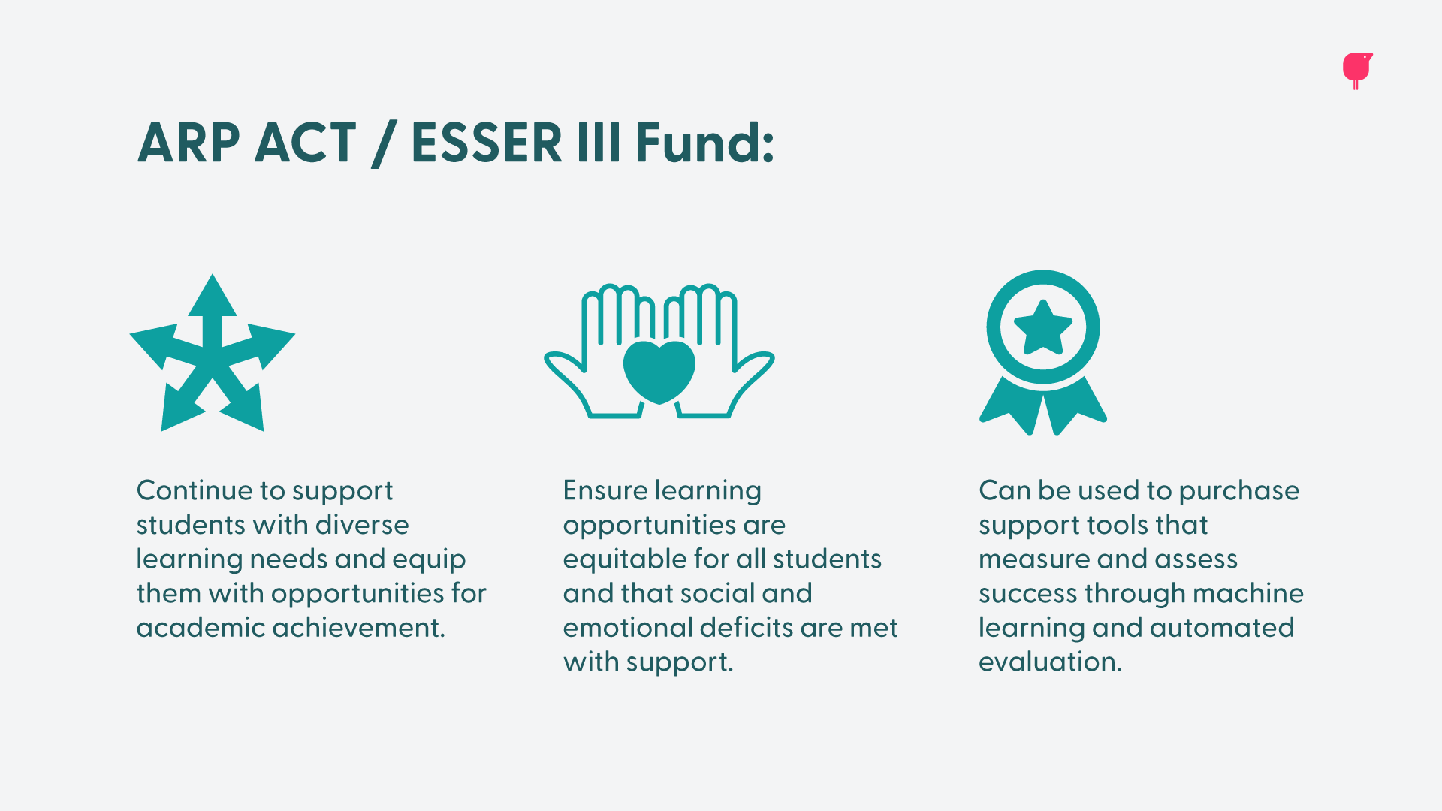

Slide 9
Seamless integrations across multiple
Learning Management Systems (LMSs)
Notes:
The best way to keep learning consistent is for students to access resources and assignments in ways they’re familiar with. That’s why we’ve built custom integrations with many of the most popular learning management systems. Our products are designed to be easy to use and integrate with whichever systems your school district is using.
* It’s important to note that for both Read&Write and the PDF Reader, the LMS integrations listed above are only a few examples. Many of Read&Write’s features are available on almost every learning management system. For more information on how Read&Write can support your teachers and students on your LMS, please contact your local territory representative.

Slide 12
Help students understand, engage and express themselves
Created with the learner experience and UDL principles in mind, Read&Write makes the web, documents, and files more accessible to anyone who needs support with their reading and writing.
Notes:
Read&Write is a literacy support tool that offers help with everyday tasks like reading text out loud, understanding unfamiliar words, researching assignments and proofing written work.
Read&Write helps with diversity in the classroom, allowing students to choose the way they access educational content, comprehend it, and communicate their learnings. From reading on-screen text aloud to researching and checking written work, Read&Write makes lots of everyday tasks more achievable for all types of learners.
Additionally, Read&Write helps students develop their social-emotional learning, as writing-practice is the foundation of academic and professional communication. Beyond the academic importance of writing, students can learn to express themselves through writing, which can lend itself to therapeutic effects.
Read&Write meets the Covid-relief funding guidelines as follows:
Support English Language Learners
Read&Write builds on the four essential skills in language learning: listening, speaking, reading and writing.
Aid students with disabilities or diverse learning needs
Our assistive technologies allow users to hear text read aloud, help with self-expression, and boost concentration while relieving visual stress.
Tools for Remote Learning
Read&Write integrates into a number of LMSs, giving you the ability to build assignments and learning materials in a familiar environment for students.
Supports remote learning
For Teachers: Provide oral feedback and generate resources fast including rich PDF resources with annotations, markup and comments. Grade and assess completed work online.
For Students: Maintain essential in-class support tools at home. Study, research and revise effectively with a range of tools. Complete assignments, worksheets and activities in PDF.

Slide 13
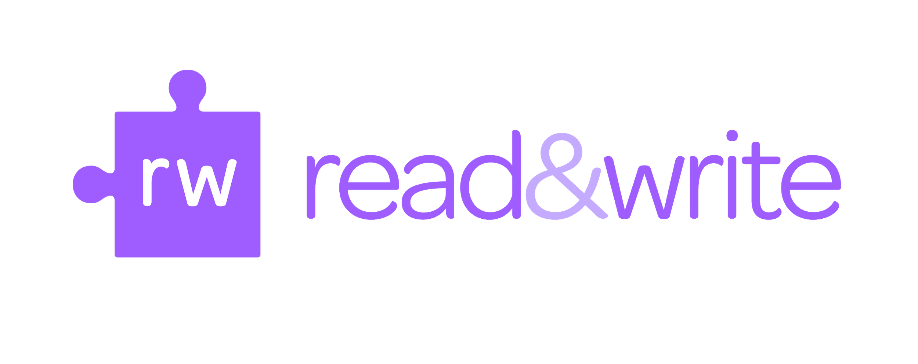
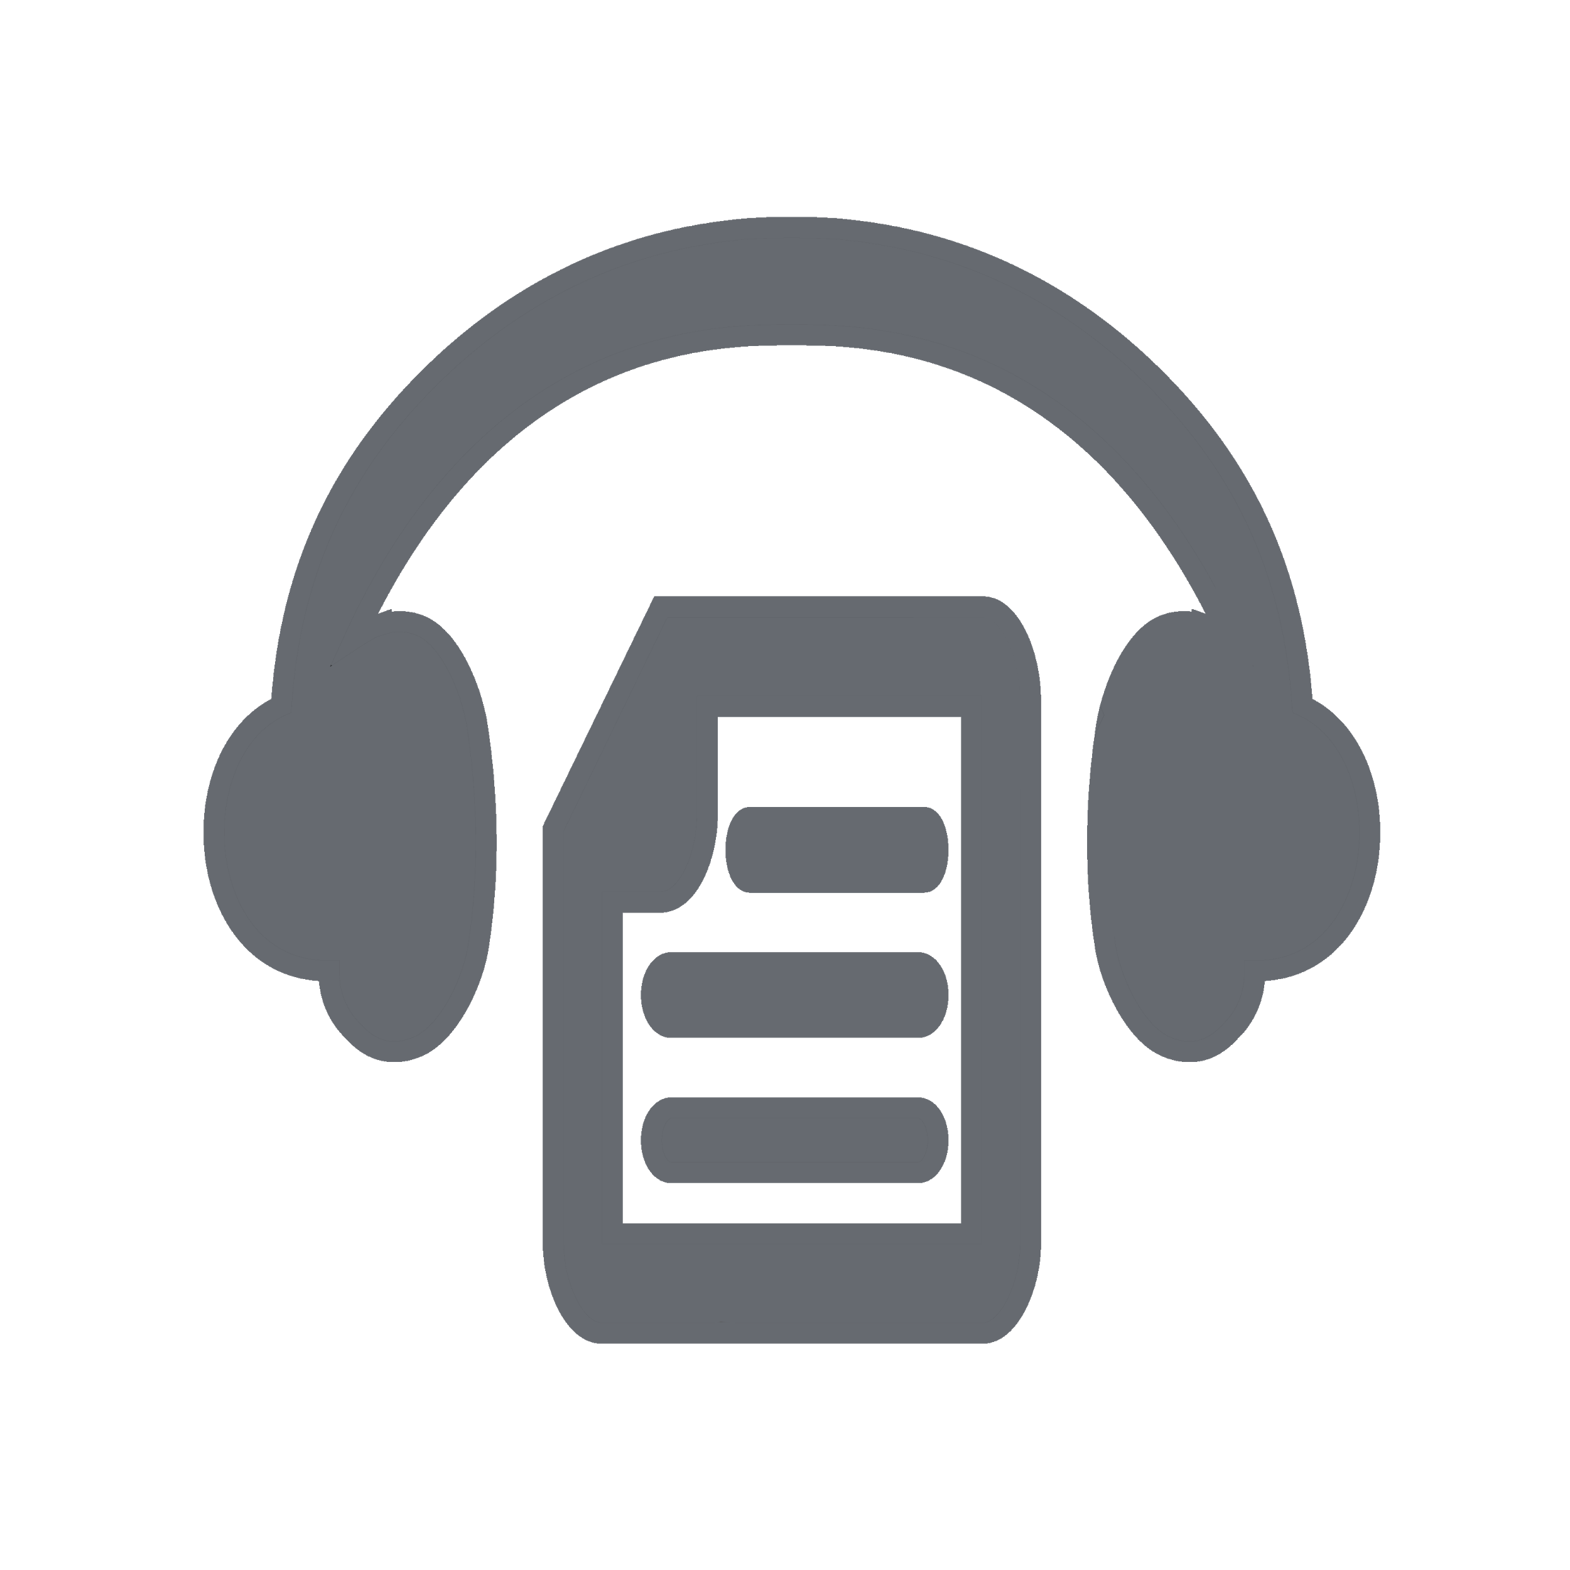
Text-to-speech: assists students by providing auditory support and building word recognition, while highlighted text helps with comprehension
Check It: promote learner agency with this phonetic spell checker that helps to solve complex spelling and grammar mistakes
Prediction: supports construction of contextually correct sentences
Translation: single word translation gives students opportunities to find the translated word that they are most familiar with
Dictionaries: support those with short term working memory and provide visual representations of a word
Talk&Type: create documents verbally while providing dictation support
Audio maker: MP3 files from words to entire reading passages can be listened to as well as orally repeated to improve auditory comprehension and fluency
Vocabulary list: create word lists for memory recall
Notes:
Read&Write is designed for online learning and supports multiple means of engagement, representation, and action/expression.
Text-to-speech with dual color highlighting
Assists students with cognitive difficulties by providing auditory support. For example text-to-speech is a useful tool as students can hear what they’ve written and rectify any mistakes that they may have missed if they were reading themselves.
Students can hear what is being read aloud and track the words on screen with dual colored highlighting, helping them to process the information more efficiently.
Hearing and seeing the words can increase word recognition.
Check It
Check It promotes learner agency and is a phonetic spell checker that helps to solve complex spelling and grammar mistakes, to improve the quality and accuracy of a written piece of work.
Prediction
Supports the construction of contextually correct sentences.
Expands students' vocabulary through the provision of language. This is particularly beneficial for some struggling learners who self-limit their vocabulary.
Students can concentrate on the context of their work rather than struggle with spelling, helping them to produce error-free papers
Recognizes the student’s style of writing for future recall.
Screen masking
Can be altered to specific prescription colors, providing a helpful screen tint.
Screen masking can be used with the reading ruler which aids tracking when reading large bodies of text. This supports students with cognitive load difficulties, by narrowing their focus to individual paragraphs.
Specifically helps students with Irlen Syndrome, a perceptual processing disorder which affects the brain’s ability to process visual information. This can also be referred to as Meares-Irlen Syndrome, Scotopic Sensitivity Syndrome, or Visual Stress.
Dictionaries
Dictionary definitions, which can be read aloud, help students to quickly discover the meaning of a word.
For students with dyslexia, dictionaries support those with short term working memory who may forget the meaning of previously known words.
The picture dictionary provides the student with a visual representation of a word, to help with memory recall.
Highlighters
A useful research tool allowing students to collect and collate information from the internet and documents, which then automatically creates a bibliography upon collection.
Students can color code pieces of work for easier processing of information.
Talk&Type
Speech-to-text helps students who struggle using a keyboard to create documents verbally.
Provides dictation support, helping those who have difficulty with constructing sentences and writing.
Audio maker
Improves speed, productivity and effectiveness for those who struggle with reading.
Many students on the dyslexia and neurodiversity spectrum prefer, or need, to hear information rather than read it.
Audio files are portable and can be transferred to any device to study on the go.
Vocabulary list
Students can create their own word lists to help with memory recall, which is particularly useful during revision.
Allows students to create vocabulary lists with both visual and auditory support.
Translation
The single word translation gives students opportunities to find the translated word that they are most familiar with based on the word they hear at home or their home country.

Slide 14
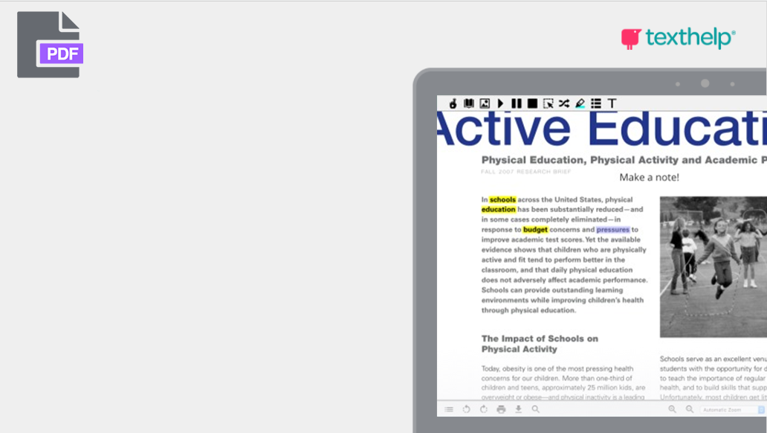
The PDF Reader (included in your Read&Write subscription) allows you to create, view and edit PDFs in new ways. By improving accessibility, collaboration and engagement.
Our PDF Reader is great for all subjects. Helping educators transform PDFs into interactive digital worksheets. Using annotation tools to add instructional notes and comments on the PDF. It provides more ways to complete online assignments and improves feedback and collaboration. All this including the support from the Read&Write tools that you know and love - in school or at home.
Notes:
The PDF reader also qualifies for covid-relief funding under the following guidelines:
It supports remote learning by allowing teachers to digitize existing paper resources
Addresses the needs of students with disabilities in that they can interact with assignments and curriculum content in ways that suit them best (for example text-to-speech features)
It’s a big help for English language learners as they can use all the features of Read&Write to help them read and understand the digital content.

Slide 16
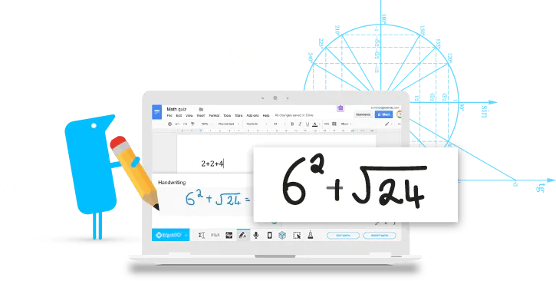
Make math digital
EquatIO allows you to create equations, formulas, and more, digitally. Helping to make math and STEM classes more accessible and engaging for every student.
Notes:
Designed with UDL in mind, EquatIO lets you make math digitally, helping to make STEM and math classes more accessible and engaging for every student.
The software toolbar and its complementary web app, EquatIO Mathspace, let you type, handwrite, or dictate equations, formulas and graphs, etc., directly on your computer, mobile device or Chromebook.
EquatIO works inside the most popular LMS systems including Canvas, Brightspace, Schoology and Blackboard and on lots of different platforms like Google, Windows and Mac. This means that your students can work with EquatIO in familiar environments.

Slide 17
Prediction: build complex math and science notations by typing simple English
Math-to-speech: provide auditory support for students with cognitive difficulties
EquatIO mobile: convert handwritten or textbook math into accessible documents and supports remote learning
Screenshot reader: read and understand inaccessible documents by reading them aloud
EquatIO Mathspace: manipulate concrete visual representations to better under concepts
Notes:
EquatIO is designed for online learning and supports multiple means of engagement, representation, and action/expression.
Prediction
EquatIO’s built in maths prediction helps students to build complex math and science notations by typing simple English without spelling errors.
Math-to-speech
When used with Read&Write, students can have math problems read aloud which:
provides auditory support for students with cognitive difficulties
improves auditory reading speed and productivity as listening to information supports more efficient auditory memory.
aids tracking and makes processing information easier, with the help of dual highlighting.
EquatIO mobile
EquatIO mobile allows students to convert handwritten or textbook maths images into accessible documents.
Screenshot reader
EquatIO’s screenshot reader allows students to read and understand inaccessible documents, like PDFs, by reading them aloud.
EquatIO mathspace
Allows students to have concrete visual representations of objects and concepts rather than abstract math
Helps students who need to manipulate those objects to better understand concepts
Supports remote learning
For Teachers: Create rich math resources and activities. Build workflows automatically. Review, grade and return student work fast. Collaborate with students on shared assignments.
For Students: Give students a collaborative platform to complete activities. Engage students with math in a fully digital way. Support individual approaches to learning.

Slide 18
Good for teachers, great for students.
For Teachers: Create rich math resources and activities. Build workflows automatically. Review, grade and return student work fast. Collaborate with students on shared assignments.
For Students: Give students a collaborative platform to complete activities. Engage students with math in a fully digital way. Support individual approaches to learning.

Slide 20
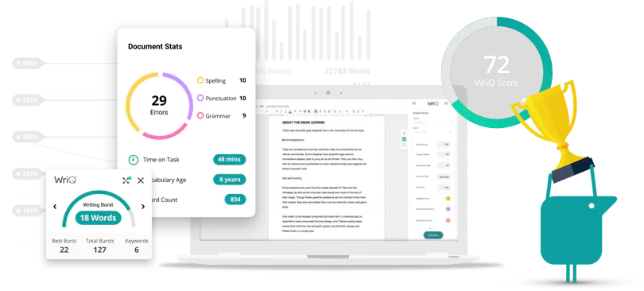
Create better writers, reduce teacher workload. Achieve more.
WriQ helps reduce the amount of time spent grading. It allows you to give students fast, effective feedback and track writing progress over time.
Notes:
WriQ is a writing achievement tool used to easily assess and motivate student writing while providing automated, meaningful feedback and delivering a standardized benchmark for grading.
The quantitative and qualitative measurements give teachers a complete picture of each student’s journey as an increasingly confident writer.

Slide 21
Tools for remote learning.
For Teachers: Track progress, including number of words written and time on task. Give students meaningful and personalized feedback in real-time.
For Students: Receive remote feedback and helpful guidance within rubrics to improve written work. Track writing fluency and visualize progress.
WriQ was one of the three Texthelp tools recognized by Tech and Learning Magazine as one of the Best Remote/Blended Learning Tools.
Notes:
WriQ was one of the three texthelp tools recognized as one of the Best Remote/Blended Learning Tools by Tech and Learning Magazine. WriQ integrates with Google Classroom and a number of learning management systems, giving you the ability to build assignments and learning materials in a familiar environment for students. Positive nudge notifications prompt them to do a little better every day. They’re only ever in competition with themselves, so there’s no pressure.
WriQ supports one of the four essential skills in language learning (writing), and helps to create better writers, while reducing the time teachers spend correcting and grading work. WriQ can automatically score students’ writing using indicators such as spelling, punctuation, and grammar, vocabulary maturity and time taken.
WriQ also aids students with disabilities or diverse learning needs by giving teachers insight to the student performance data, which in turn allows teachers to identify areas that may require additional support or intervention.

Slide 22
The dashboard: Keep writing assessments consistent with a host of data and metrics on the WriQ dashboard. Easily track student writing progress and back up
your reporting with data.
The WriQ score: Accurately measure and track improvement in student writing. Compare your students’ progress with others in the same class, school, and even at a national level.
Custom Rubrics: Assess student writing with WriQ’s built in rubrics to keep assessment consistent. With the ability to add your own custom rubrics, writing
assessment is in line with subject, region, or national standards.
The student experience: Put students in charge of their own learning with the WriQmeter, which allows students to see their own progress and improvements.
Notes:
WriQ helps reduce the amount of time spent grading, in some cases, up to 40%. It allows you to give students fast, effective feedback and track writing progress over time.
The dashboard: Keep writing assessments consistent with a host of data and metrics on the WriQ dashboard. Easily track student writing progress and back up your reporting with data.
The WriQ score: Accurately measure and track improvement in student writing. Compare your students’ progress with others in the same class, school, and even at a national level.
Custom Rubrics: Assess student writing with WriQ’s built in rubrics to keep assessment consistent. With the ability to add your own custom rubrics, writing assessment is in line with subject, region, or national standards.
The student experience: Put students in charge of their own learning with the WriQmeter, which allows students to see their own progress and improvements.

Slide 24
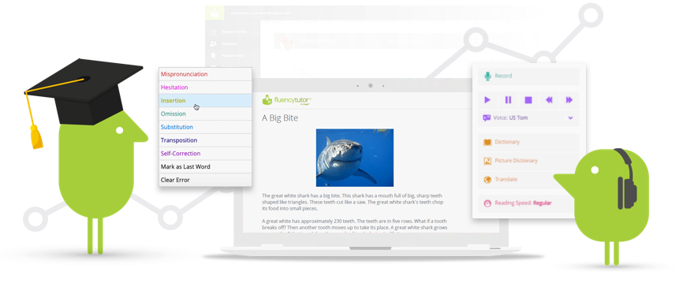
The reading assessment tool
Track and assess oral reading progress, in school and online.
Notes:
Fluency Tutor makes reading aloud more fun and satisfying for students who need some extra support.
It’s a big help for struggling and reluctant readers, as well as those students learning English as a second language.
Fluency Tutor allows students to record themselves reading a passage, which they can share with their teacher - ideal for busy teachers and classrooms where students may be working at different paces.

Slide 25
Support your ELLs with Fluency Tutor
Fluency Tutor easily integrates with Google Classroom to help busy teachers bring struggling readers up to speed.
Fluency Tutor for Google makes reading aloud more fun and satisfying for students who need extra support.
Fluency Tutor lets students record themselves reading and share with their teacher away from the pressures of reading aloud in the classroom environment.
Fluency Tutor helps struggling readers and English Language Learners alike, with features including a dictionary, text-to-speech, and translation— and it’s Google compatible.
Notes:
English Language Learners needs vary greatly – from those being introduced to English for the first time to those who are proficient in conversational English, but require additional support in reading and writing due to the complexities of the English language.
Fluency Tutor helps to support ELLs and struggling readers alike, with built-in features including a dictionary, text-to-speech, and translation.
All English Language Learners need technology that supports their learning journey, as well as the ability to work independently in a self-paced environment, and the opportunity to be active and engaged learners. Fluency Tutor helps students gain confidence in their reading abilities and make progress towards their goals.
-Fluency Tutor also integrates with Google Classroom, to help busy teachers bring struggling readers up to speed.
-Fluency Tutor for Google makes reading aloud more fun and satisfying for students who need extra support.
-Fluency Tutor lets students record themselves reading and share with the teacher - away from the pressures of reading aloud in the classroom environment.
-Ideal for schools using G Suite for Education, Fluency Tutor for Google integrates seamlessly with Google Drive and Google Classroom. And since it works with almost any online content, it’s great to use alongside other online instructional programs.

Slide 26
Reading aloud: students gain confidence while they practice reading aloud, focus on pronunciation and listen back to their own reading as much as needed before they submit to their teacher
Text-to-speech: increase word recognition with auditory support
Dictionary & Picture Dictionary: support those with short term working memory and provide visual representations of a word
Translation: single word translation gives students opportunities to find the translated word that they are most familiar with
Feedback and Scoring: teachers can give immediate feedback to students through digital scoring and commenting
Progress monitoring: identify struggling readers and put interventions in place
Notes:
Fluency Tutor features include text-to-speech, dictionary, and translation tools, which help struggling readers. By giving students access to support tools, they can begin to build their understanding and confidence.
Reading aloud
Students can practice reading aloud, focus on pronunciation and listen back to their own reading as many times as needed before they submit to their teacher for assessment and feedback.
Reading aloud allows students to gain confidence as a reader and develop an appropriate use of prosody or meaningful oral expression while reading
Text-to-Speech
Assists students with cognitive difficulties by providing auditory support. Text-to-Speech is a useful tool as students can hear what they’ve written and rectify any mistakes that they may have missed if they were reading themselves.
Students can hear what is being read aloud and track the words on screen with dual colored highlighting, helping them to process the information more efficiently.
Hearing and seeing the words can increase word recognition.
Dictionary & Picture Dictionary
Dictionary definitions, which can be read aloud, help students to quickly discover the meaning of a word
For students with dyslexia, dictionaries support those with short term working memory who may forget the meaning of previously known words
The picture dictionary provides the student with a visual representation of a word, to help with memory recall
Lexile level passages
Fluency Tutor has a library of over 500 leveled reading passages, based on content, lexile level or reading age
Feedback and Scoring
Teachers can give immediate feedback to students through digital scoring and commenting
Provides regular and substantive educational interaction between students and their teachers
Progress monitoring
Teachers are able to quickly identify struggling readers and put interventions in place to help the student achieve their next step in learning without falling further behind
Translation
The single word translation gives students opportunities to find the translated word that they are most familiar with based on the word they hear at home or their home country
Supporting remote learning
For Teachers: Track progress over time, assess key reading fluency skills and comprehension. Give quick feedback or a more in-depth assessment of reading progress online.
For Students: Motivate students to read, Practice reading aloud, rehearse and record before submitting to the teacher. Built-in supports for comprehension and understanding

Slide 27
Implementation resources
Notes:
By purchasing Texthelp tools you get access to much more than just the products. There’s a whole host of implementation resources including onboarding guides, certification programs, live tech support, lots of how to videos and the blog, which is updated regularly with a mix of product focused content as well as guest blogs from industry experts.

Slide 29
Next Steps:
You have 30-day access to premium features for students
Free domain-wide pilots are currently available to any school district interested
Free online professional development
Webinars / Demonstrations can be scheduled
Licensing Quote

Slide 31
?
what next?
have a question?
questions

