Slide 1
Introducing Read&Write
A toolbar to help every student succeed

Slide 2
Read&Write literacy software is a discreet toolbar, proven to improve students’ reading and writing,
in class, at home
and in exams.
works seamlessly with virtually any kind of educational content - such as websites, Microsoft Word files, PDFs and Google Docs
with features to support a diverse range of learners

Slide 3
Every student can benefit from Read&Write
It’s particularly beneficial for those who:
would like to be more independent learners
have English as a second language
use a human or digital reader in exams
have additional learning needs, for example dyslexia

Slide 4
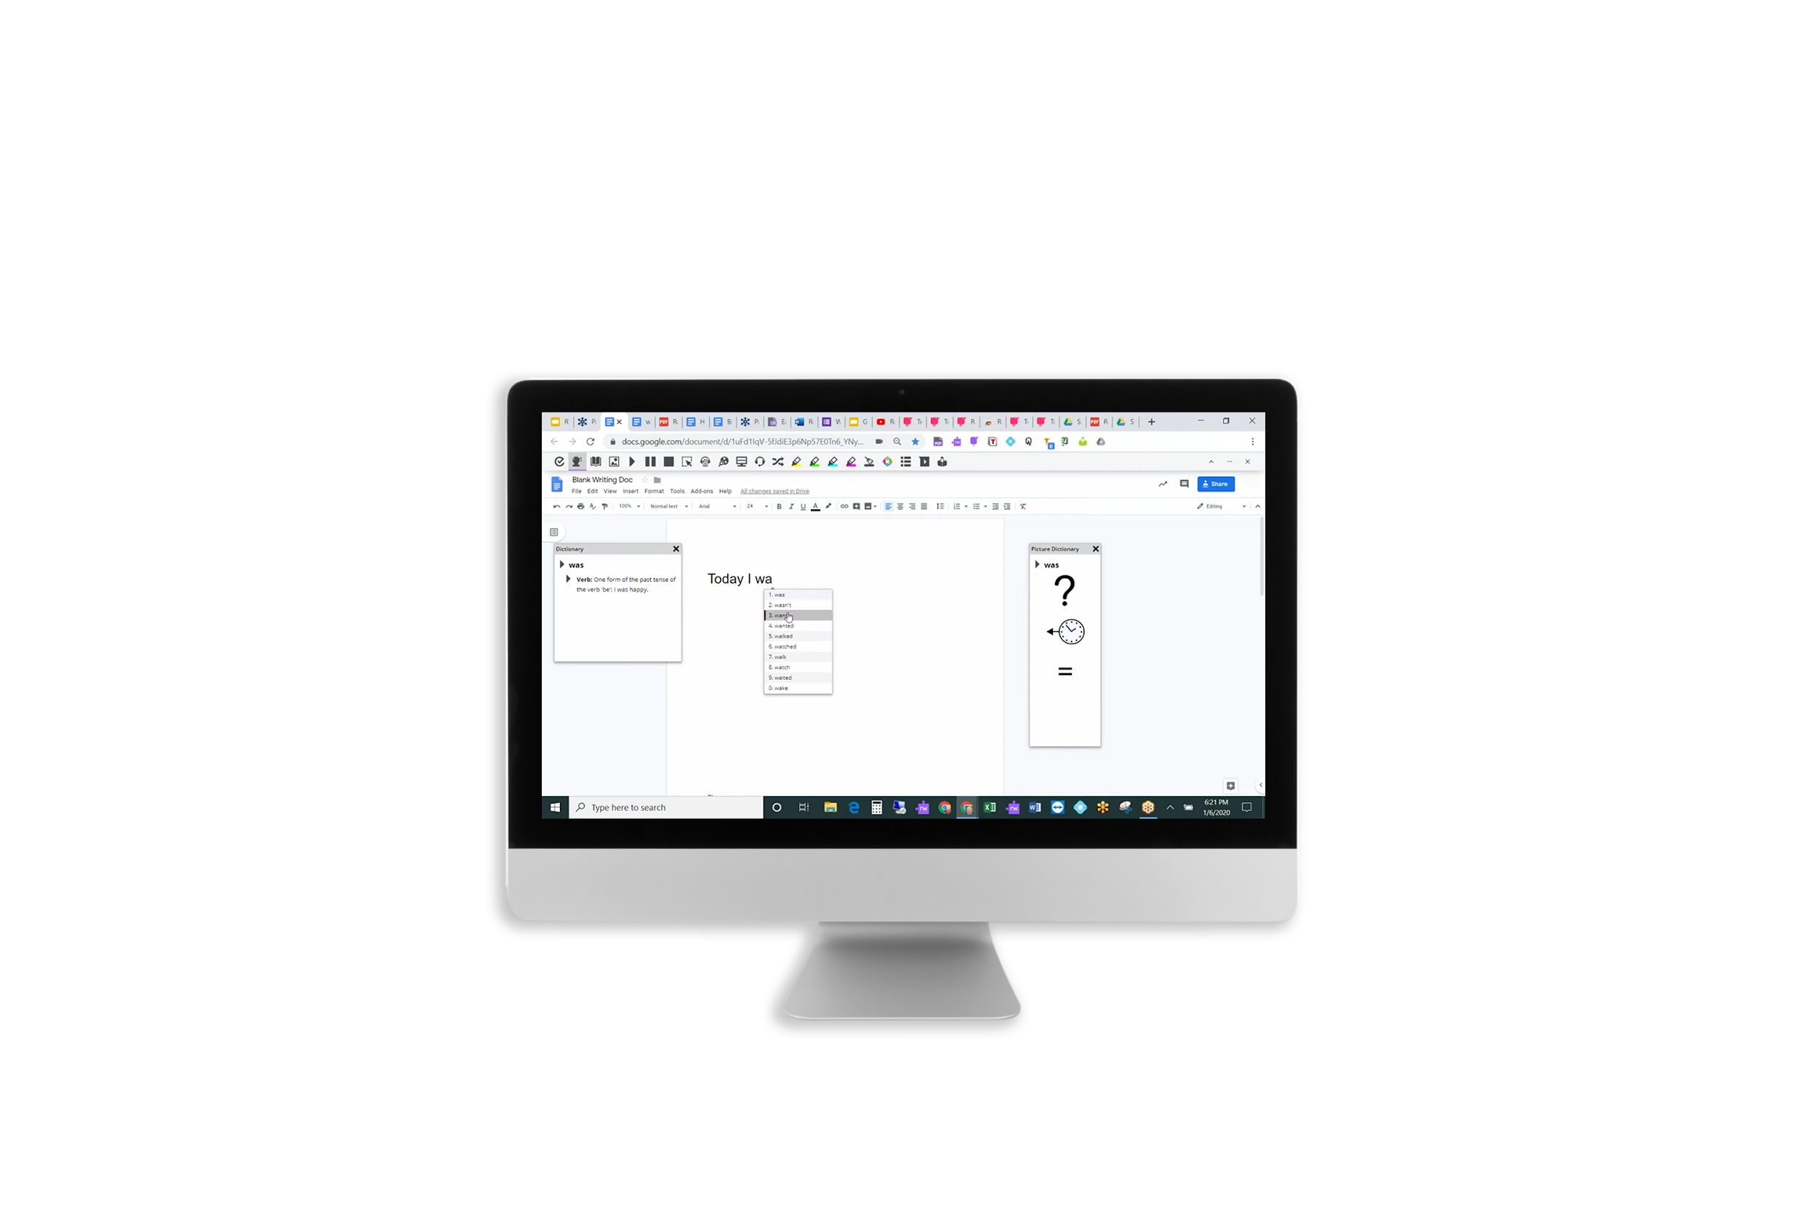
Key features

Slide 5
Tools for reading & writing
Text to Speech:
Text & Picture Dictionaries:
Word Prediction:
reads words, passages, or whole documents aloud with easy-to-follow dual colour highlighting.
provide deﬁnitions and displays images to help with word comprehension.
speeds up writing by suggesting frequently used words, helping to expand student vocabulary.

Slide 6
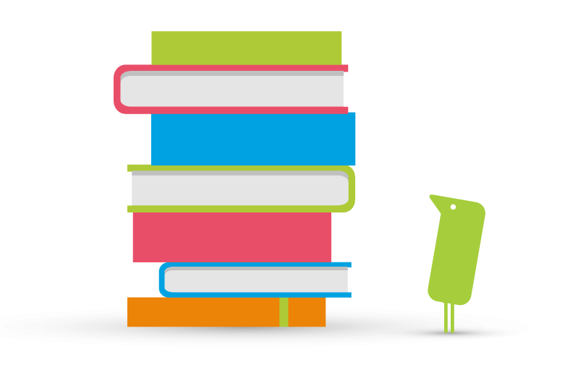
Tools for homework
Check It:
Talk & Type:
reviews writing for incorrect grammar, spelling (phonetic), capitalisation, punctuation, verb tense, homophones and more to help students check the accuracy of their own work.
turns the spoken word into text, allowing students to focus instead on the quality and context of what they’re writing.

Slide 7
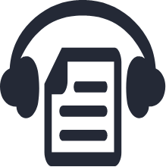
Tools for revision
Audio Maker:
Vocab List:
Highlights:
converts class content like PDFs and Textbooks to audio files, to listen on the go or to support auditory learners.
instantly create a vocabulary list of key phrases into a new doc, including dictionary definitions.
colour coded highlighters to collate key information, at the click of a button.

Slide 8
Support in exams
For students who require a human or digital reader in exams, Read&Write can help.
Using the toolbar in exam mode means students can access text to speech, PDF Aloud and screen masking features.

Slide 9
Available now
Discover how Read&Write can support all students to reach their full potential.

