Slide 1
3 lessons educators can teach us about improving neurodiversity inclusion at work

Slide 2
Martin McKay
Founder & CEO
Texthelp

Slide 3
We create technology to help everyone understand and be understood.

Slide 4
Whether at school or work, when we understand, we are more confident and more likely to succeed.

Slide 5
We must create a better working world for those of us who think, work and learn differently.

Slide 6
That’s quite a few of us…
15-20% of us have a neurodiversity such as Dyslexia, Autism and ADHD. That’s 1 in 5 of us.
Despite this, neurodiversity and disability is usually the forgotten piece in the diversity and inclusion agenda.

Slide 7
That being said…
2016. 90% of companies said they prioritised diversity and inclusion, yet only 4% considered disability in their initiatives.
2018. Just 1 in 10 organisations said they included neurodiversity in their people management practices.
2022. 94% of HR and D&I professionals have established neurodiversity and disability inclusion best practices into their workplace.
But we’ve still got a long way to go.

Slide 8
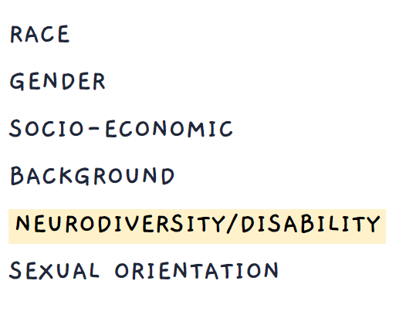
Our recent research tells us…
Neurodiversity/disability is often low in the list of priorities
64% of neurodivergent workers believe their organization could be doing more to support them
61% have experienced stigma in the workplace
56% have experienced communication barriers at work
32% have experienced lack of career progression

Slide 9
We need to work together to create environments that include and support people with different strengths.

Slide 10
Improving neurodiversity inclusion at work.
3 lessons learned.

Slide 11
Lesson 1.

Slide 12
More people are neurodivergent than we might realise.
Lesson 1.
76% of people with a disability or neurodiverse condition do not fully disclose this at work.
44% worry their career would be negatively impacted. 42% worry they’d be viewed differently. Negative misconceptions exist. Being made to feel different can be a worry.
10% of us are dyslexic, however it’s estimated that this figure is more likely to be 16%. Not everyone with dyslexia is diagnosed.
We mustn’t rely on our employees to self-identify. We must create an inclusive space with support available to everyone.

Slide 13
At one stage of my career I started working for a government department where there was a lot of reading and writing. I had a really bad time, and was almost fired. Basically because dyslexia wasn’t recognised back then. Thankfully I ended up with a really good Line Manager who put me in for an occupational health assessment where I received my diagnosis and inclusive technology Read&Write.

Slide 14
Our workplaces must be a somewhere that employees are supported, and feel comfortable and confident to be themselves.

Slide 15
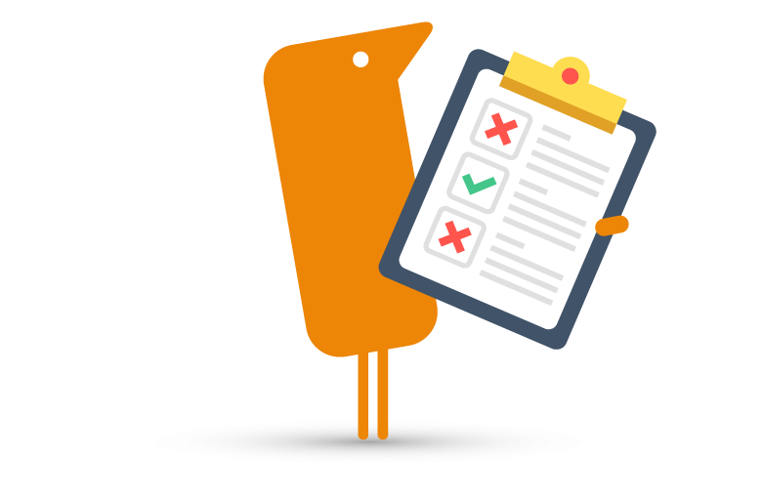
This means…
Having tools and resources in place that are available to all staff. Not just those who have asked for extra support.
Making time and space for employees to share their challenges. And in these moments, encourage feedback, listen and respond proactively.
Creating an environment where employees feel comfortable to open up and be themselves. In the process, inspire open conversations by being transparent ourselves.

Slide 16
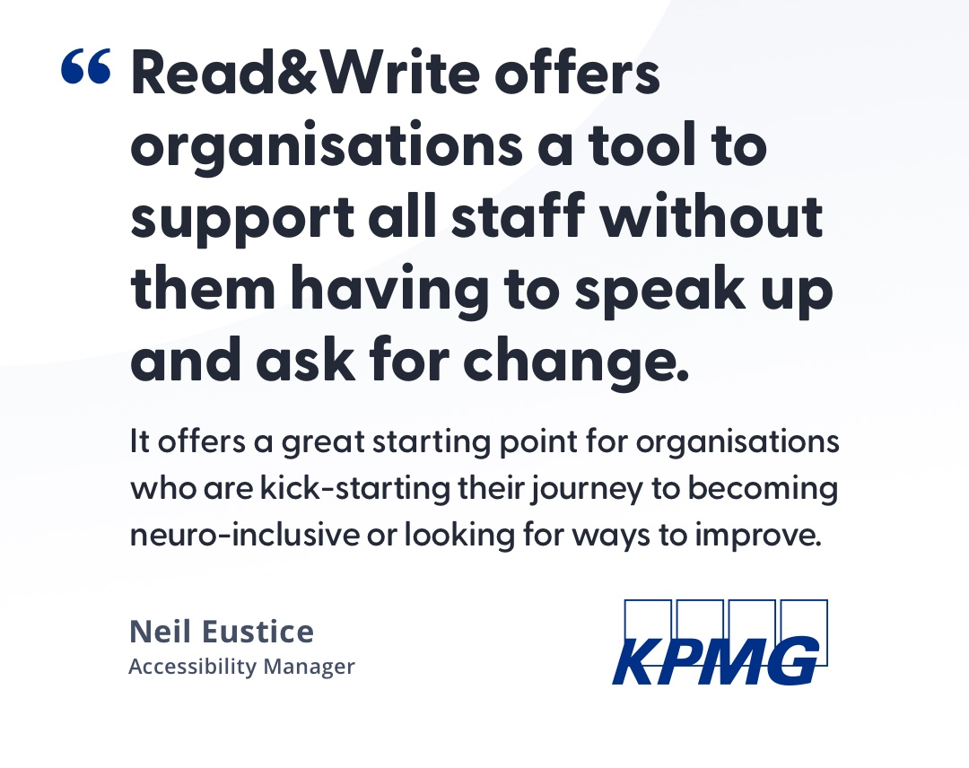
An example…

Slide 17
Lesson 2.

Slide 18
The
Universal Design
Mindset
is key.
Lesson 2.
The Universal Design mindset allows people with diverse abilities to live and work together side by side.
It assumes that barriers are in the design of the environment, not in the person.
With this mindset, the workspace can become a place that is truly inclusive

Slide 19
Notes:
So this is not a universally designed staircase.
Wheelchair users would struggle with this from an accessibility point of view.
We try to use this lens to look at the working experience for people.
If you struggle with reading - this is what a page of text can look like.

Slide 20
Notes:
These steps are a beautiful example of universal design.
You can see the ramp built into the steps.
This sends a very clear message about inclusion. The ramp is a feature.
It was designed in from the start.
We try to make our software like these steps.
Not software for disabled or neurodivergent people.
Software that all people find easy to use.

Slide 21
Our workplaces must be a place where different ways of thinking and doing are encouraged.

Slide 22
The principles of Universal Design for Learning
Engagement. Allowing choice, encouraging autonomy and meeting different needs.
Representation. Giving information in ways that everyone can take in and understand.
Expression. Encouraging ways of working that suit each individual, so they can thrive in every task.

Slide 23
What about Universal Design at Work?
Engagement. If you want to engage your employees is an email the best way?
Representation. Think about reading ability when you are writing copy for staff or customers - the average reading age in the UK is 9. Is that the only way to get the message across?
Expression. Maybe allow people to express themselves with slides or visuals and a voiceover rather than a long document

Slide 24
This means…
Looking critically at your office space and digital working environment. What barriers exist to different ways of working? Ask your people for their feedback. Be willing to adjust.
Looking critically at your processes and available resources. Do they discourage staff autonomy and creativity?
Keeping accessibility and inclusivity at the heart of everything. Communicate in multiple formats. Offer digital tools to help staff understand in their own way.
Amplifying employee voices. This could be achieved with feedback surveys, Employee Engagement Groups, Neurodiversity and Disability champions.

Slide 25
Inclusive technology offers a small change with big impact for neuro-inclusion.

Slide 26
A loyal companion through all stages of life.
Offers instant and discrete support for those of us who think, learn and work differently.
Benefits neurodivergent staff as well as those of us with low literacy, English as a Second Language, and conditions that affect reading & writing.
It also creates a more inclusive workplace for everyone. Its features empower different workstyles & benefit all people.

Slide 27
Engagement. Participation.
Employees are supported in how they work. They can participate in their own way & collaborate more effectively. They feel valued for who they are, and motivated to succeed.
As Deirdre says Read&Write can give all staff the confidence to realise;
"I’m not different, I just do things differently and I’m well capable, like everybody else.”

Slide 28
Lesson 3.

Slide 29
Deliberate inclusion leads to great things. For everyone!
Lesson 3.
Closed Captions / Subtitles
Ramps / Kerb Cuts
Alexa
Audible (Talking Books)
Word Prediction
Neurodiversity includes all of us. With deliberate inclusion, we can empower neurodiverse teams to thrive.

Slide 30
Empower unique talents…
Dyslexia. Pattern recognition. Innovative problem-solving. Detailed story-tellers. Out-of-the-box thinking.
Dyspraxia. Creative. Holistic. Strategic. Highly motivated. Empathetic.
ADHD. Resilient. Ability to hyperfocus. Energetic drive. Work well under pressure.
Autism. Loyal. Honest. Ability to hyperfocus. Passionate. Attentive. Detail-oriented.

Slide 31
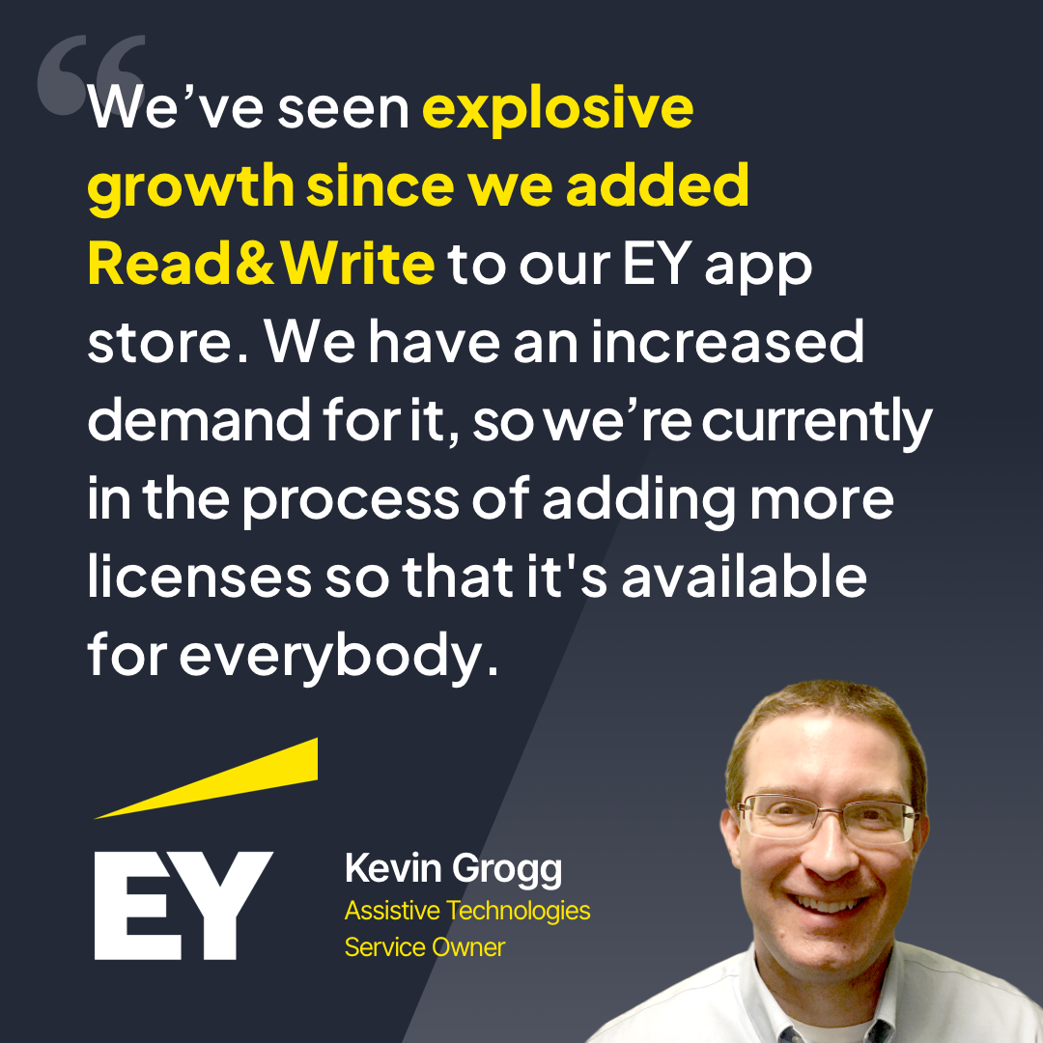
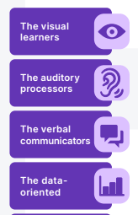
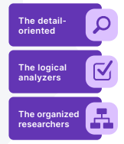
Support neurodiverse teams to thrive…

Slide 32
Organisations that prioritise neurodiversity inclusion are better placed to attract, retain and develop diverse talent.

Slide 33
Any questions?
Discover more: texthelp.com/workplace
text.help/inclusion-whitepaper

