Slide 1
Support me to
Power My Potential
Here’s how

Slide 2
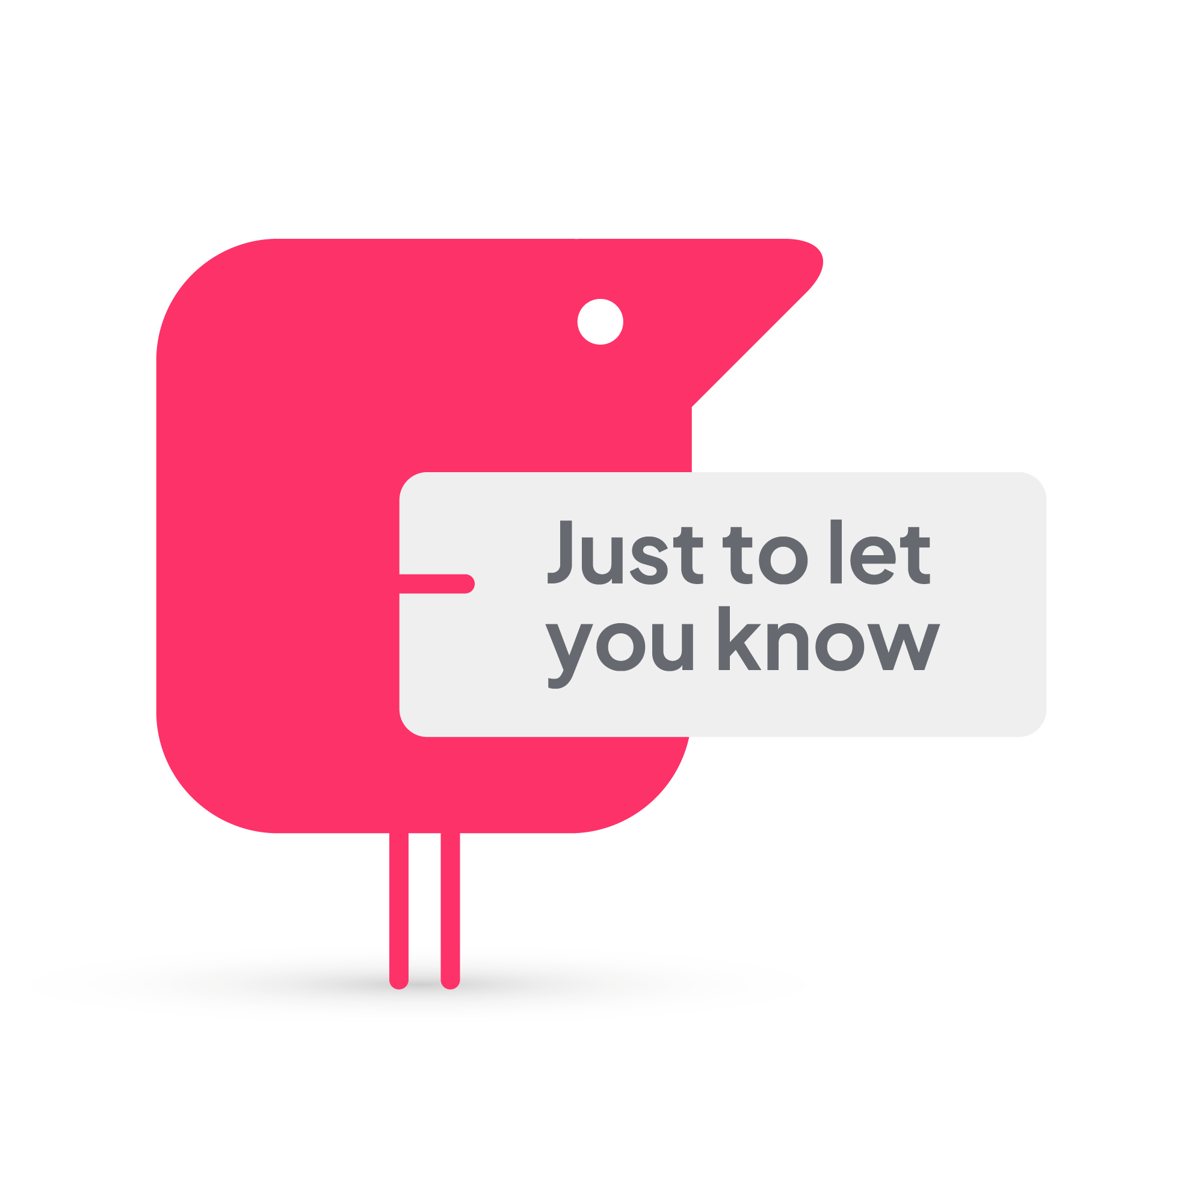
First, I’d like you to know…
I have/I’m insert your neurodiversity/s
This means I think, learn & process in a unique way. It also means I need to be able to work and achieve how I do best.
When I’m empowered to be me, my talents can shine.

Slide 3
It’s not unusual. In fact 1 in 5 people have a neurodivergent condition
Neurodivergence includes ADHD, Autism, Dyslexia and Dyspraxia
Notes:
One in 5 people are neurodivergent.
That’s one in 5 people in your organization.
Up to one in 5 people across the globe are neurodivergent.
Across the world, 10% of the population is dyslexia, 6% are dyspraxic, 5% have ADHD, and 1-2% are autistic. Of this population it is estimated that less than 50% have been formally diagnosed.
76% of people with a disability or neurodiverse condition do not fully disclose this at work. 43% of employees with disabilities or conditions do not feel comfortable to approach their employer to ask for change
It is estimated that less than 50% have formally diagnosed.

Slide 4
I’m great at…
List what you’re good at here
Hint: If you’re not sure, think about what other people have told you you’re good at
Example: People with Dyslexia are often good at solving problems, connecting ideas that others might have missed, recognizing patterns, and big-picture thinking. They often have great long-term memory and the ability to think in 3D
Example: People with Autism are often creative and artistic. They often have superb memory, concentration, and great attention to detail. They’re often very honest and loyal
Example: People with ADHD are often resilient, proactive, and passionate about their interests. They often have the ability to hyperfocus and think creatively

Slide 5
But, at times I have challenges with…
List what you often find a challenge at work
Hint: Think about the different tasks you carry out. Is there anything that makes it harder for you to complete those tasks?
Hint: Think about your environment. Is there anything about the office space or your desk setup that distracts you or makes it harder to concentrate?
Hint: Think about the different ways you interact with colleagues. For example, is there anything about meetings that you find a challenge?
Hint: Think about how you plan out your day. Is it easy to prioritize and organize your tasks?
Hint: Think about how you receive information. Is there anything about the way you’re briefed or given projects that makes it difficult to understand what’s expected?

Slide 6
To unlock my full potential, I have strategies that help me to overcome my challenges.

Slide 7
My strategies include…
List what you already have in place to help you overcome challenges
Hint: Do you take notes in meetings to support memory challenges? Do you wear noise cancelling headphones to reduce distractions?

Slide 8
You can help me by empowering me to continue these strategies. There’s also ways you can help me to elevate them.

Slide 9
You can support me by…
Highlight what you feel your manager could do to help you carry out your strategies
Example: This could be to allow plenty of time in between meetings so you have time to digest information and type up your notes. It could also be to arrange for someone to take meeting minutes in face to face meetings, or to record virtual meetings
Also share anything your manager could put in place that you don’t already have
Example: This could be providing written briefs for all tasks, with expectations and deadlines clearly noted. It could also be to set up weekly check-ins with your manager to discuss workload and prioritize tasks
Example: This could be providing you with technology, software and equipment which helps you with work related tasks

Slide 10
I’ve also found this really great tool with features that’ll give me flexibility in how I work, engage with content, and communicate.

Slide 11
from inclusive technology specialists

Slide 12
I’ll let Texthelp explain how it’ll help me & my peers…

Slide 13
First, a little bit about Texthelp…
A global software company, supporting inclusion in the workplace
Launched 1996
50M+
regular users
350+
Texthelpers

Slide 14
Our Mission:
We want to help unlock everyone’s full potential through inclusive technology.
Our Vision:
We strive for a world where everyone can understand and be understood

Slide 15
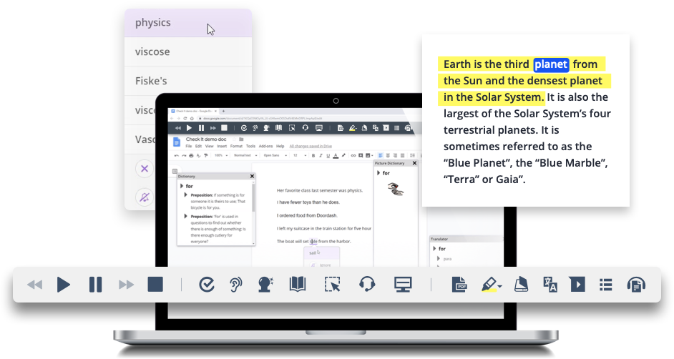
Read&Write for Work
An inclusion tool that empowers all employees to think, learn and work to their full potential. Especially people with neurodiverse conditions such as Dyslexia, Autism, ADHD, Dyspraxia and non native English speakers
Reading, writing, research & collaboration tools to empower employees to excel across all aspects of work
Brings instant support to those of us who struggle with digital text in some way

Slide 16
Features at a glance
Text-to-Speech reads on-screen text aloud, which helps to reinforce understanding, increase focus and improve retention
Highlights allows users to collect digital content from multiple sources, with automatic source referencing
Check It reduces writing errors with an advanced grammar, spelling and homophones checker
Audio Maker converts large documents into MP3 files for listening on-the-go
Word Prediction intuitively predicts word entry, helping employees to maintain focus and flow
Voice Notes allows employees to provide detailed feedback more easily and faster
Screen Masking with reading pane reduces visual stress and improves focus
Scan converts paper documents and inaccessible PDFs into accessible digital documents

Slide 17
Text to Speech tools
#ReadAndWriteWork
Reads on-screen text aloud, offering an alternative to reading digital text. Hearing text read aloud reinforces understanding, increases focus and improves retention. It’s also a powerful proofreading tool.
Rewind
Play
Pause
Forward
Stop

Slide 18
Neurodiversity tools
Support the different ways we understand and are understood. They particularly improve accuracy and confidence for neurodivergent users, but empower all of us to learn and work in the style that suits us best.
Check It
Similar Word Checker
Prediction
Dictionary
Screenshot Reader
Dictation
Screen Masking

Slide 19
Research & Collaboration
Make it easier to consume, retain, and summarize large amounts of information. Allow users to choose how they offer feedback, as well as supporting multi-lingual teams.
PDF Reader
Highlights
Scan
Translator
Voice Notes
Vocabulary List
Audio Maker

Slide 20
Powerful benefits for all employees.
Read&Write is particularly helpful for neurodivergent employees. But it also offers benefits to all other employees.
People who struggle with everyday literacy tasks
100% of us, because we’re all unique!
Multi-lingual teams

Slide 21
What Read&Write users say

Slide 22
In my previous job I didn’t have Read&Write. I was extremely anxious and would second guess my work & spend way longer in documents that I needed to.
Now that I have Read&Write, I have peace of mind. I can easily check my work, and I have confidence to give it to my manager or a peer without feeling like I'm going to get judged.
Chelsie Spencer
Read&Write user with Dyspraxia
Discover how Read&Write supports Dyspraxia.

Slide 23
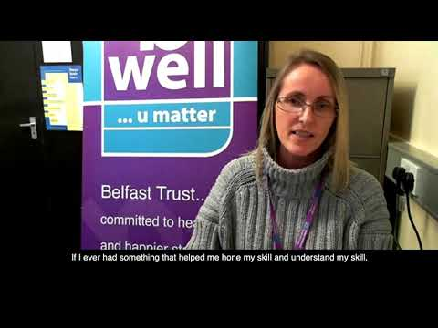
I struggled all my life with my neurodiversity... I found it very difficult to feel able to have achievements.
I know that if I’d Read&Write as a child, I would be a doctor today. That was my dream that I never fulfilled.
Deirdre Williamson
Read&Write user with Marfan Phenotype

Slide 24
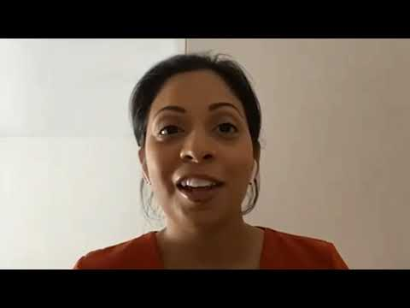
Read&Write is very user-friendly and it literally changed my working life for the better!
I just felt less stressed. It just gave me confidence that I could do my job and I deserved to be in my position.
Taljinder Duggal
Read&Write user with Dyslexia and Dyspraxia
Discover how Read&Write supports Dyslexia.

Slide 25
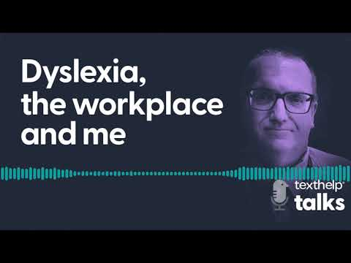
I feel that Read&Write has been a substantial part of me making my promotions and taking me to where I am today.
Colin Moloney
Read&Write user with Dyslexia
Discover more stories.

Slide 26
What I love about Read&Write is that it can be easily made available to everyone on my team to use. And they do use them, even if they’re not neurodivergent.
It makes me feel more included because I don't see myself as using special software or having anything special to do my job, because the software has been normalized.
James Deignan
Read&Write user with ADHD

Slide 27
Trusted by organizations including...
…& many more.

Slide 28
Read&Write supports
50 million people worldwide.
Discover how Read&Write can unlock the power of your people and your business.
Reach out to Texthelp.

