Slide 1
the power of personalisation
technology to transform teaching and learning
With Tracey Catling, Nick Brierley & Greg O’Connor

Slide 2
Greg O’Connor
Asia Pacific EdTech Manager, Texthelp
Tracey Catling
Leader of Learning - Curriculum Support
eLearning Mentor
St Augustine's Primary School
Lismore Catholic Schools
Nick Brierley
Y6 Teacher and School Exec
Sacred Heart Catholic Primary School, Mosman
Sydney Catholic Schools
Google Certified Educator and Innovator
Breakout EDU Authorised Trainer

Slide 3
What is personalised learning?
Tailoring learning for each student’s strengths, needs and interests–including enabling student voice and choice in what, how, when and where they learn–to provide flexibility and supports to ensure mastery of the highest standards possible.
https://www.inacol.org/news/what-is-personalized-learning/

Slide 4
Personalisation vs. Differentiation vs. Individualisation
http://www.personalizelearning.com/2013/03/new-personalization-vs-differentiation.html

Slide 8
the power of digital tools
transform learning environments
for both students and teachers

Slide 9
Nick Brierley

Slide 10
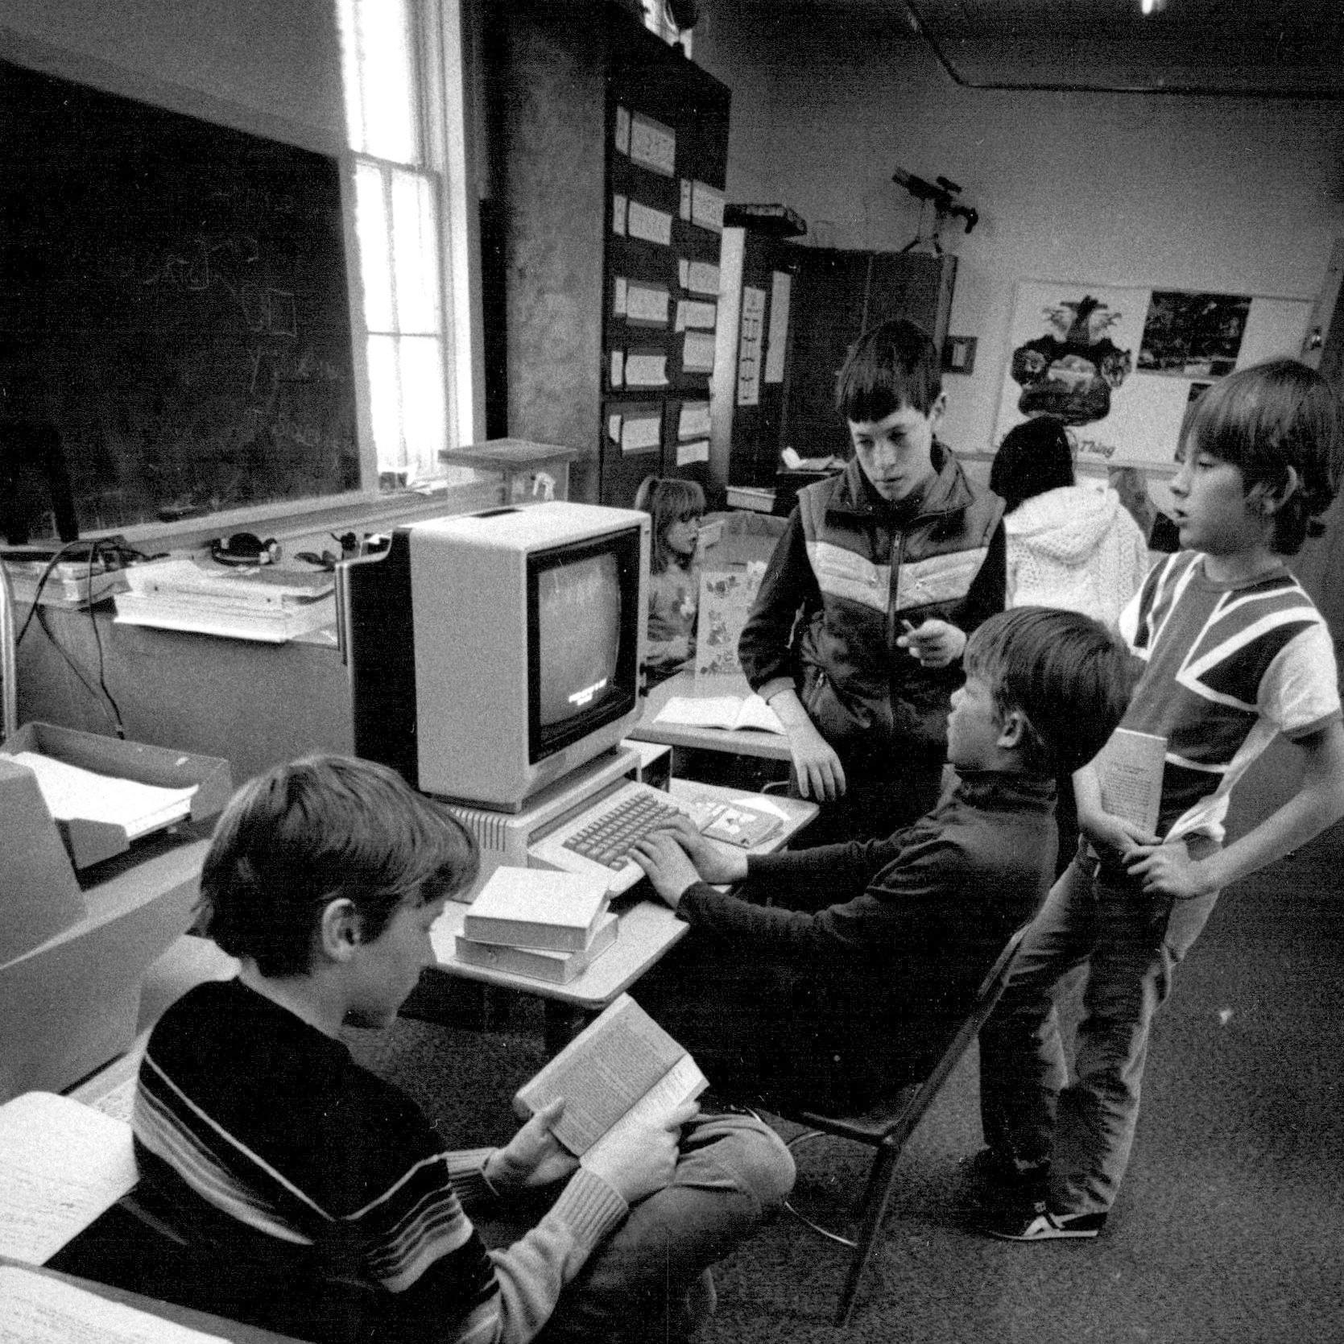
Nick’s slides

Slide 13
POSSIBILITY

Slide 14
Key Values:
Independence
Self reliance
Deeply rooted in
Personalisation

Slide 16
Tracey Catling

Slide 17
When I went to school...

Slide 18
I would have loved a classroom where differentiation and personalisation were at its core.

Slide 19
Students feel a sense of:
Ownership
Choice
Success

Slide 20
boost student engagement,
enthusiasm and confidence

Slide 21
Tracey Catling

Slide 22
Reluctant Writers

Slide 23
Relationships are key!

Slide 24
When a student knows you know them and how they learn, they engage, feel
safe and respond to learning.
Edtech allows students to choose to learn how they prefer, and gives them the confidence to extend themselves.

Slide 25
Take the benefits of text-to-speech with Read&Write for example -
My students love this feature to help them with spotting their mistakes.
I think our method of writing is helping me to become a better writer for multiple reasons. Swapping books with a partner and listening to Read and Write helped me to hear it from another perspective, and the partner gave me constructional feedback. Drafting and editing let me make those changes and to elaborate, and publishing told me that this was the final piece, and I was happy with it. Also, marking my own rubric gave me my own opinion and I tried to make it as honest as possible! - A.S.
I think listening to my writing helped because somethings that I read in my head made sense, but really they were just a collection of random words. - O.S.

Slide 26
Nick Brierley

Slide 27
“School”

Slide 29
Key Values:
Independence
Self reliance
How?
Personalisation

Slide 30
Personalisation.. How?
Access to information
Access to tools
=
ACCESS TO LEARNING

Slide 31
Engagement.. How?
Quality Teaching and Learning
(That naturally embeds technology!)

Slide 32
Engagement.. What?
Blended T&L:
Explicit Teaching & Inquiry Learning

Slide 33
features of edtech tools
enable student voice and choice in the classroom
actively motivate and encourage inspiring learners
enable more productive and efficient teaching and learning

Slide 34
Nick Brierley

Slide 35
Student Voice
What are we doing?
Student Choice:
How are we doing that?

Slide 38
Finding new tools for your classroom...

Slide 39
How do we motivate students?
Give them a reason to care..
make it matter!
Audience?
Purpose?

Slide 40
Educational technology helps us to maximise time with our students, ensuring that learning and achievement of all students remains of paramount importance.

Slide 41
Tracey Catling

Slide 42
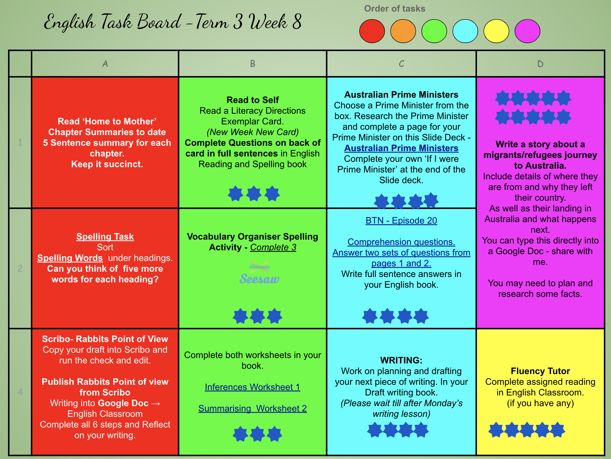
Choice in Learning
English Choice Boards using Google Drawings

Slide 43
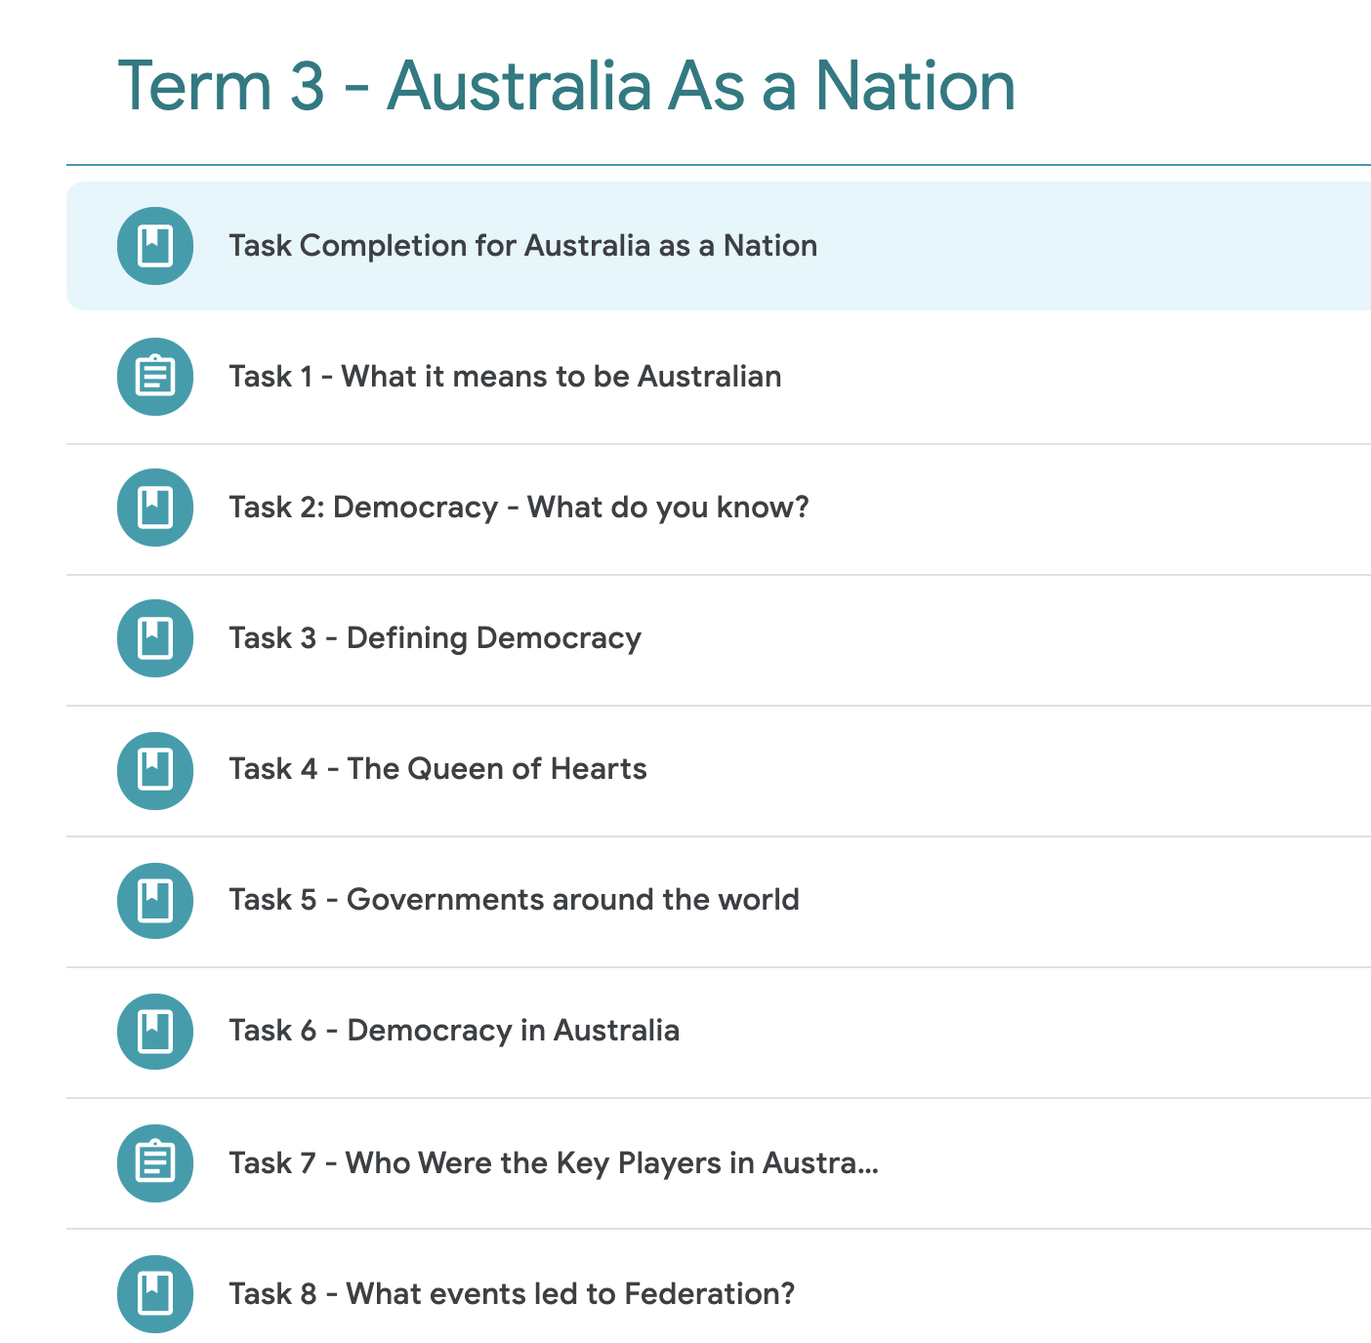
Go at your own pace
Sequenced Tasks in Classroom or on a Slide Deck

Slide 44
Show what you know...
Using Seesaw students can explain their learning.

Slide 45
Assigning Tasks is great when Edtech works together.
Fluency Tutor & Classroom
Read and Write & Google Docs
Speech to Text & Seesaw

Slide 46
If students know what an Edtech Tool can do…

Slide 47
want to know more?

Slide 49
www.texthelp.com/en-au/company/education-blog

Slide 51
Texthelp AsiaPac Facebook Group
www.facebook.com/groups/TexthelpAsiaPAC

Slide 52
we’re here
to help
Your Asia Pacific team
asiapac@texthelp.com

